Slide 1
Welcome to
Joydens Wood Infant School

Slide 2
Senior Leaders
Headteachers – Gerard Strong & Rachel Hately
Deputy Headteacher – Emma Blake ( on maternity leave )
Operations and Safeguarding Manager – Carly Adams
EYFS Leader – Ellie East
SENCo- Amy Vinton

Slide 3
Housekeeping
Fire Alarm
Mobile Phones
Toilets

Slide 4
Our Ethos
To create a happy and safe place
To ensure our school values underpin EVERYTHING we do
Child-led learning
Nurturing our school community

Slide 5
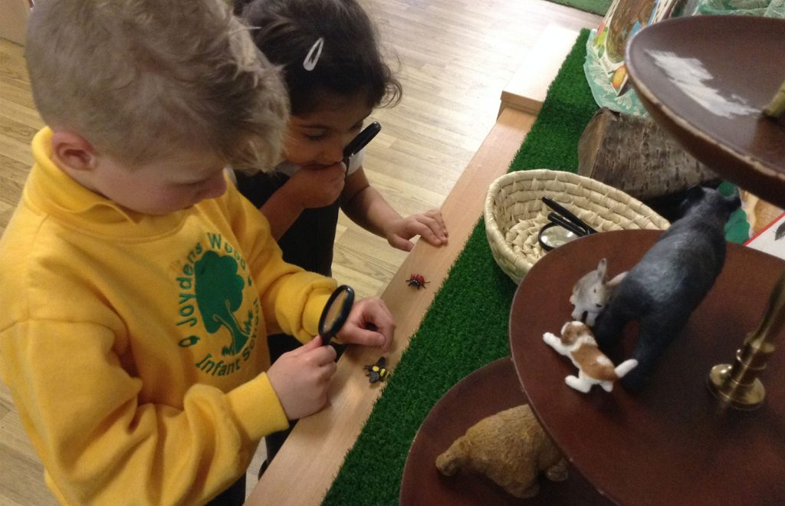
Targeted Teaching
Carefully designed curriculum – a blend of formal and play-based learning
Clear progression of skills
Targeted phonics and reading programme
Specialist lessons in cooking and PE with Tollo our PE Specialists

Slide 6
Structure of Play
Art Studio
(Art and design)
Exploration Room
(Playdough, science, cultural resources and investigation areas of interest)
Imaginary Room
(Construction, role play, small world, cooking)
EYFS
Physical Development, Communication and Language, Personal Social and Emotional Development, Maths and Literacy
Continuous provision in the afternoon provision
In Autumn and Spring Terms and gradually phase it out.
Art and design reading and writing
History, geography, maths investigations, RE, museum
Complex construction, science investigations, cooking workshop
Year 1

Slide 7
Joydens Wood Infant School’s curriculum
Allows the children to develop independence and expertise through a succinctly planned Progression of Skills and Knowledge.
Every element is carefully considered so the children have a strong grasp of how their prior knowledge enables them to be successful in their future learning.
Our Curriculum is designed to ensure our children have a progressive educational journey that enables them to:
• Develop strong fluency and confidence in the foundations in Literacy and Mathematics
• Lead their own learning through child-led and enquiry-based opportunities
• Think critically and make links through a cross curricular approach which is underpinned by key texts

Slide 9
SEND
At Joydens Wood Infant School, we follow a 5 Step Plan for SEND concerns.
Step 1- Quality First Teaching
Step 2- Interventions and discussions within Provision Map meetings
Step 3- School Inclusion Forum Team meeting (internal meeting regarding what other strategies and support we can offer)
Step 4- 6 weeks to try the recommendations and review
Step 5- Referrals to outside agencies (Local Inclusion Forum Team, Speech and Language Team, Occupational Therapists, Educational Psychologist)
If a child’s provision is above and beyond Quality First Teaching then a Personalised Plan is implemented to outline specific interventions, strategies and resources. This is then reviewed with Class Teacher and parents every 6 weeks.
Interventions we offer at our school are: Drawing and Talking, Sensory Circuits, BEAM, Clever fingers, Phonics intervention, Social Skills group and Size of the Problem.
We have a whole school approach to visuals. All classrooms have a consistent visual timetable, now and next board, emotions chart and labeled resources with pictures and words.

Slide 10
Pastoral Support
The Nurture School
Wellbeing Practitioner
Specialist Support
Jigsaw Programme
Our pastoral aim is to equip children to understand who they are, to be healthy, happy and caring people.
There is a strong emphasis on emotional wellbeing and mental health.
Mrs Adams is a our Senior Mental Health Lead and can be contacted
via email c.adams@joydens.org if you feel your child will need
extra pastoral support upon transitioning into school.

Slide 11
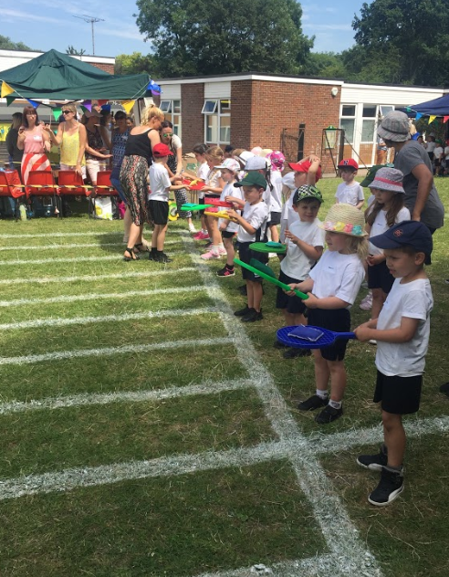
Sporting Opportunities
Specialist PE teachers
KS1 – 2x PE lessons per week, EYFS – 1x PE lesson per week
Competitive games at lunchtime
Competitions internal/external
Sports Day
Nurturing interests/sporting talents
Providing clubs

Slide 12
Community
Active School Council
Supporting the elderly and vulnerable
Church and Residents Association
Special Assemblies – parents/community
Working parties

Slide 13
Transition
Applying for our school applications open 5th November – 17th January
Preschool visits undertaken by our Senior Leaders – EYFS Lead, SENCo and Senior Mental Health Lead
Transition Stay and Plays (with and without parents)
Parents Networking Event (Hayden, clubs, school uniform, SLT, catering)
Home visits in September
Allocated a Year 2 Buddy in September who sits with them at lunch in their first few days
Length of Time | Staggered Start | 8.30-11.30 | 8.45-1.00 | Full Days
Day 1 | Allocated a timeslot 8.30,8.45,9.00, 9.15 and 9.30 | ✔
Day 2 |  | ✔
Day 3-4 |  |  | ✔
Day 5 |  |  |  | ✔

Slide 14
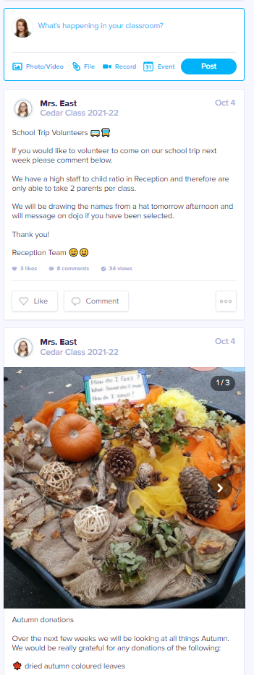
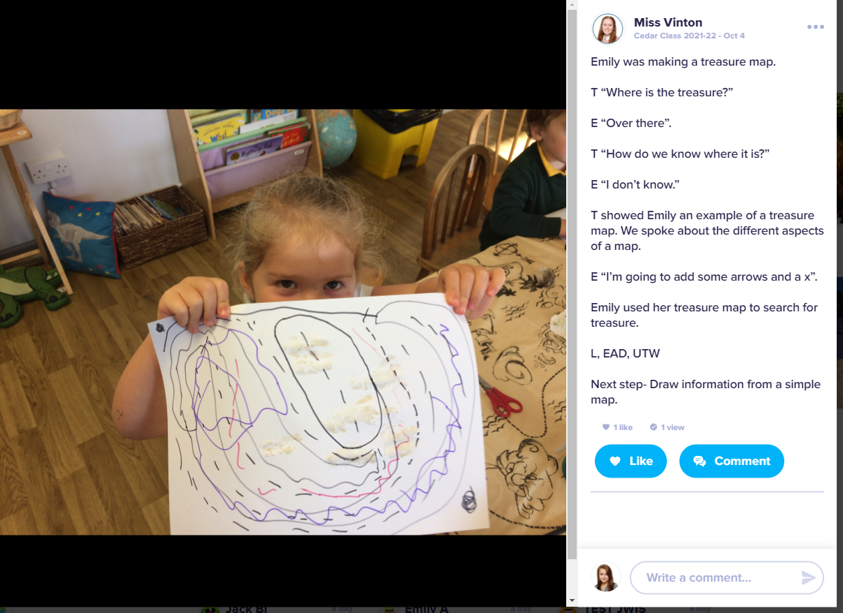
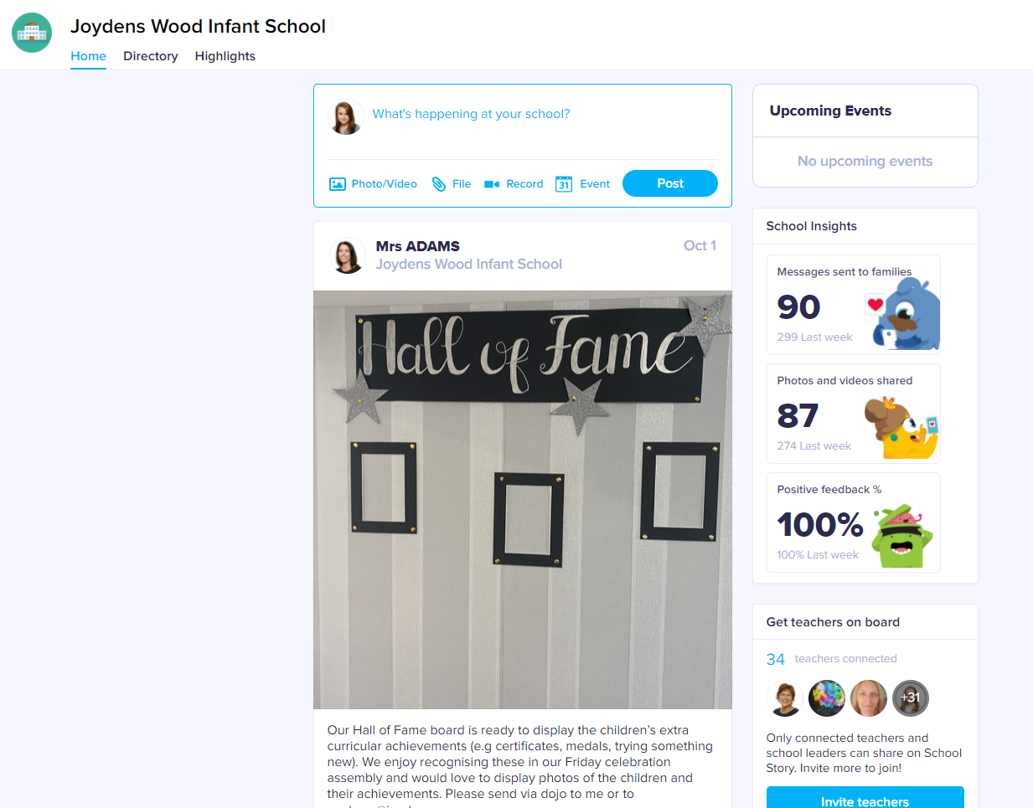
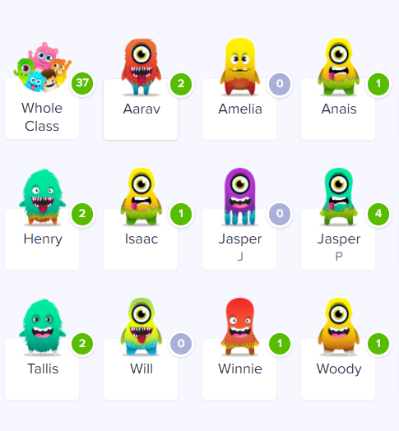
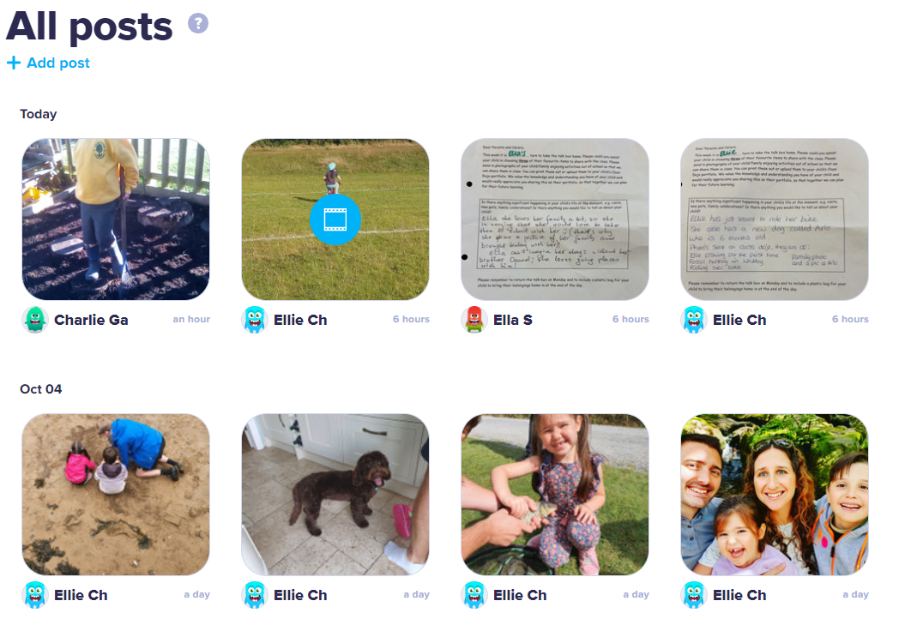
Sharing your child’s progress - Class Dojo

Slide 15
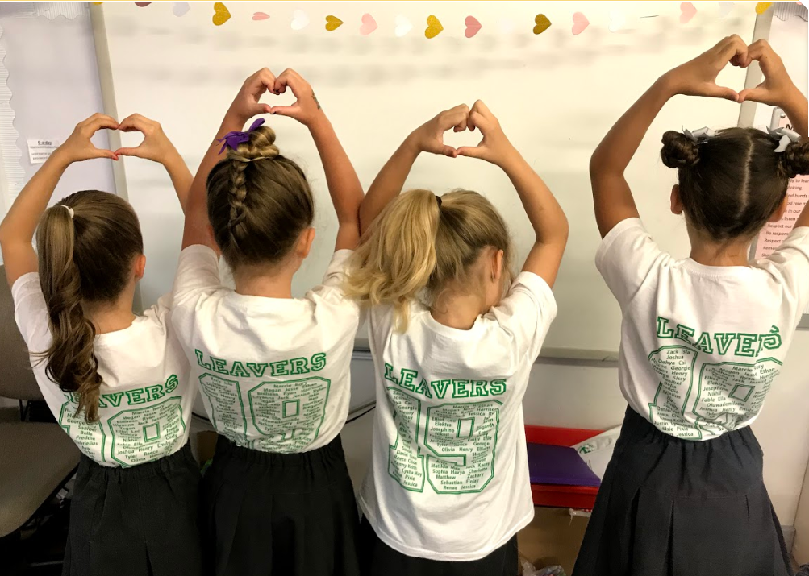
Moving On
Joydens Wood Junior School
Admissions process
Aligning term dates/inset days/events
Shared events e.g. assemblies, productions
Transition

Slide 16
Frequently Asked Questions
What are the school hours? 8:45am – 3:15pm
How many classes do we have and what is our staffing ratio?
3 classes per year group. Class sizes have capacity for 30. We aim for 2 members of staff per class
What’s our catchment area?
We don’t have one unless oversubscribed
How do we cater for children with SEN/additional needs?
In a holistic and collaborative way, we are very open and honest about the journey your child is on at our school and strive to begin to have these conversations prior to children starting who may have additional needs
Do the children get homework?
All children receive a reading book and access to our online learning platforms: Maths Seeds & Reading Eggs with tasks set weekly based on the previous week’s learning. KS1 also receive weekly spellings on Spelling Shed.

Slide 17
Frequently Asked Questions
How do we communicate regularly with parents?
ParentMail, Facebook, Instagram, Class Dojo
How do we cater for food allergies?
Mrs Quinn (Catering Business Manager) meets parents, we have an open dialogue to ensure you are kept informed (please see flyer)
What after school clubs are on offer?
Multi sports, gymnastics, football, arts and crafts, dance, cheerleading and science club
Do you offer any wrap-around care?
Joydens Wood breakfast and after school club are located a short walk away in the Juniors School building, this runs from 7am-6pm.
Do we go on school trips?
Yes – each year group will go at least once a year with additional trips to the local area where possible e.g. Joydens Wood, library, Stanhill Farm

Slide 18
Any further questions?

